Slide 1
APC + MV cleaning Procedure
Prepared by: Robin羅彬森
Dept: S200 Furnace
Loc: 38359
Notes:
115/11/21
Confidential

Slide 2
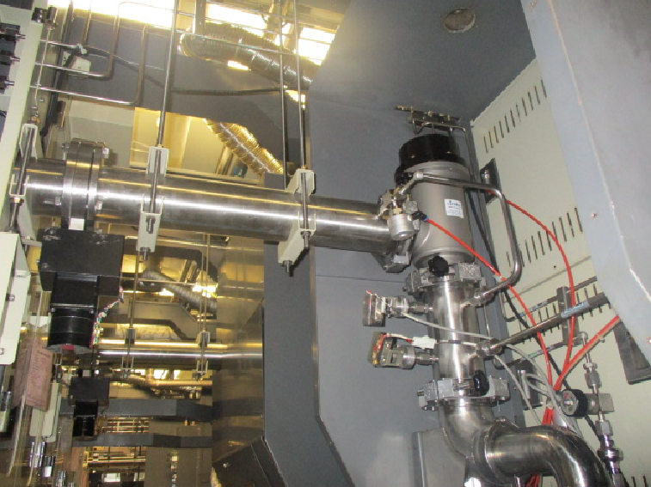
APC - Automatic Pressure Controller
MV - Main valve
MV
APC
Clean frequency APC + MV
LP-Poly → every 5BPM
LP-Nitride → every 4BPM
LP-Teos → every 3BPM

Slide 3
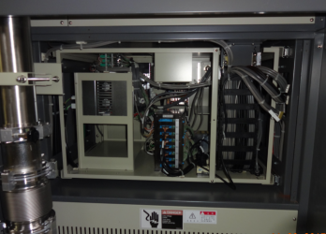
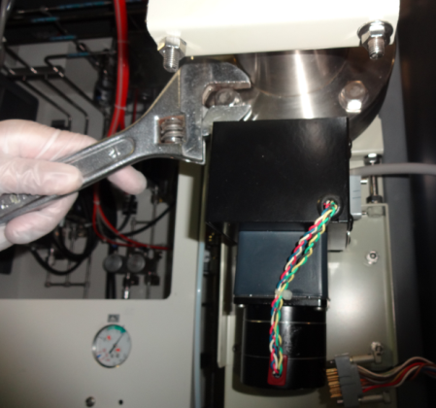
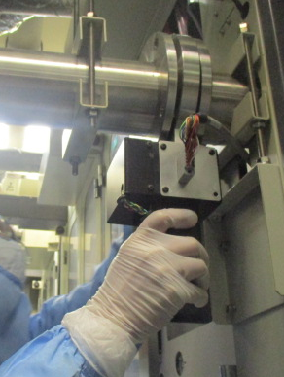
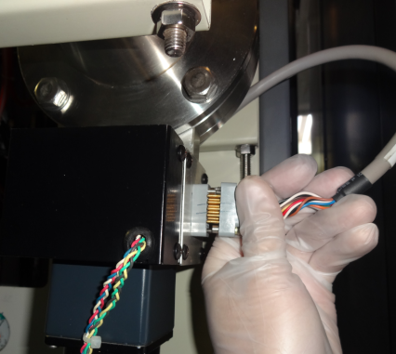
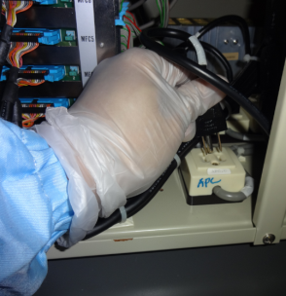
Remove APC Automatic Pressure controller
2. Disconnect APC power cable
3. Remove APC mounting screw x4
1. Unplug APC power
(backside of machine)
4. Slowly pull down to remove APC

Slide 4
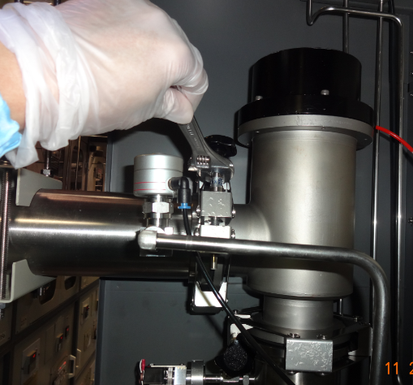
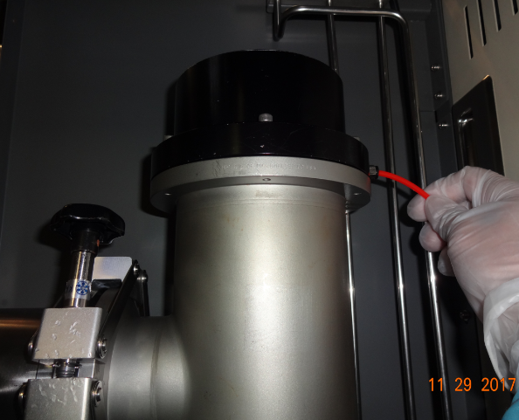
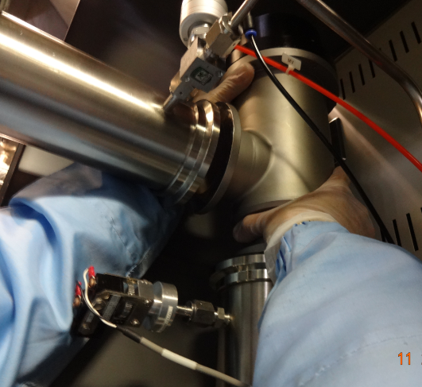
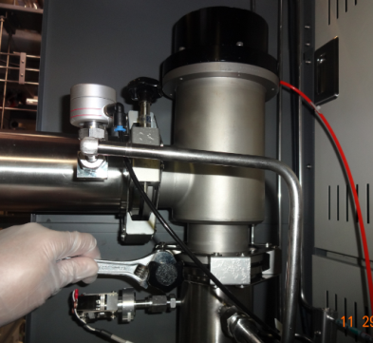
Remove MV Main Valve
3. Pull up slowly and remove MV
1. Disconnect air hose to solenoid valve
2. Remove 2 Clamp

Slide 5
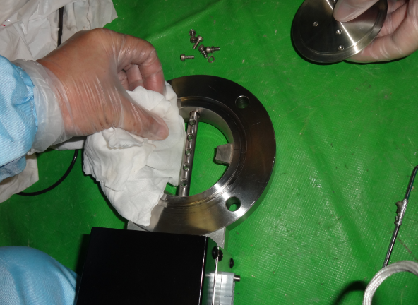
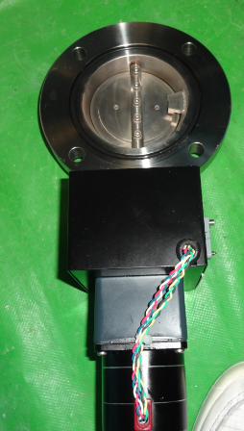
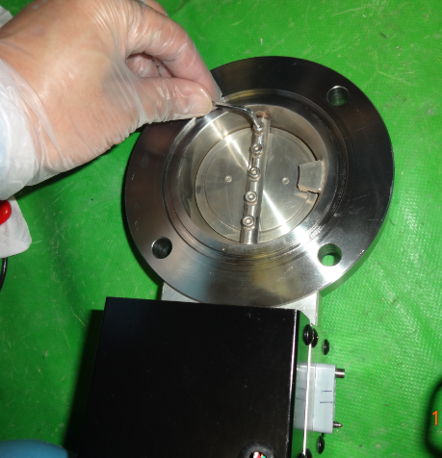
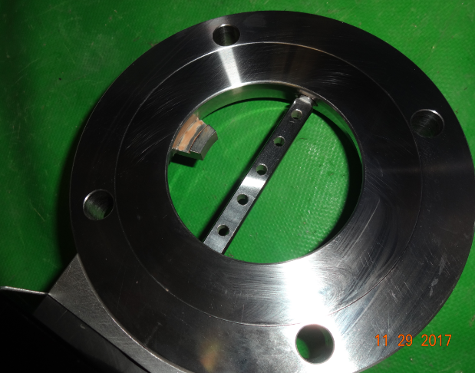
APC Assembly and Cleaning Procedure
APC Assembly
APC Shutter
1. Remove APC shutter screw (x5)
2. Clean APC Parts using cloth and IPA then Install
APC Motor – control rotation of shutter

Slide 6
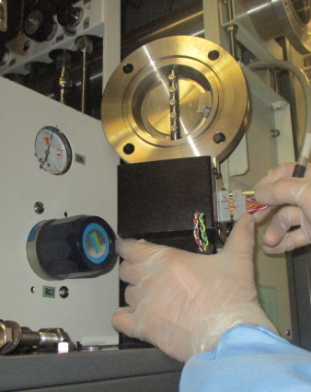
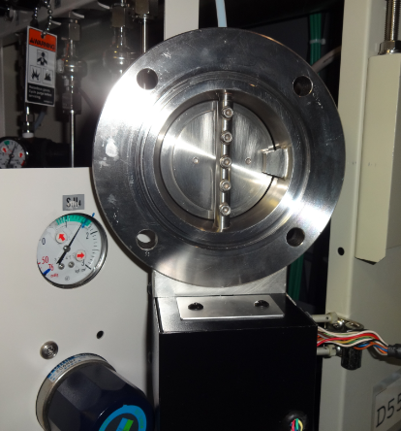
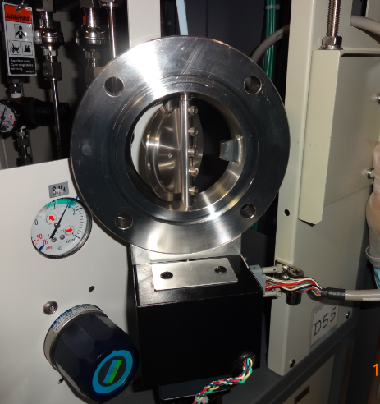

APC Test
- in front of machine controller move APC set OPEN and CLOSE 3 times
Gap = 1mm
2. Move to CLOSE and check value → 25 ±5
3. Move to OPEN and check value → 500 ±5
Assemble APC and
connect power supply

Slide 7
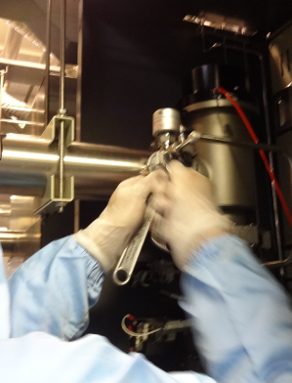
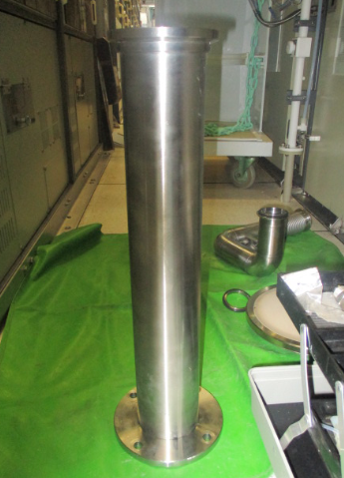
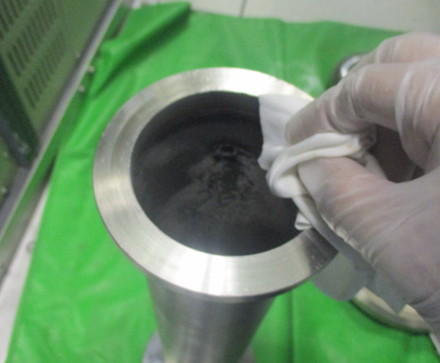
Exhaust piping cleaning
Remove SV pipe to clean
exhaust pipe
2. Bring down exhaust pipe and clean by cloth and IPA, then install

Slide 8
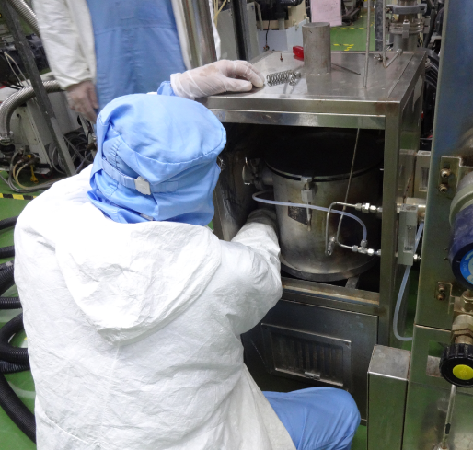
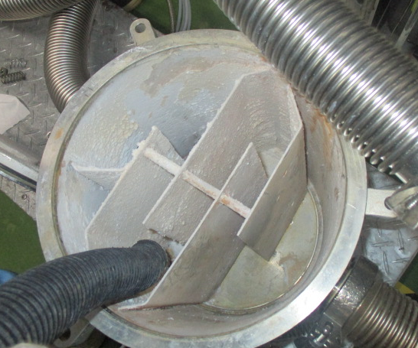
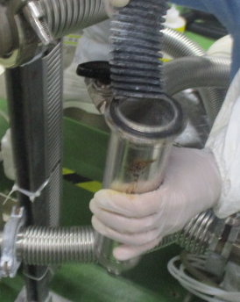
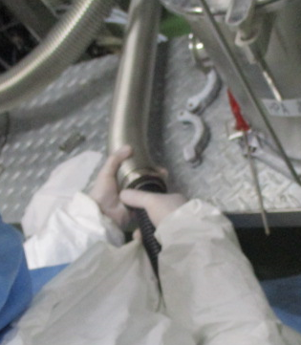
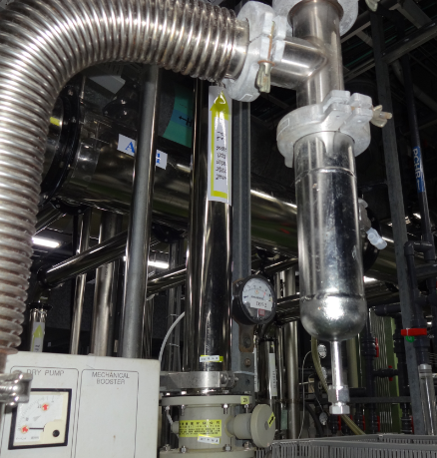
BURN BOX Cleaning Procedure
1. Remove burn box top cover (3screw)
2. Clean inside burn box using low vacuum
3. Remove particle catcher to clean
4. Use low vacuum to clean particles
5. Clean pipe to pump

Slide 9
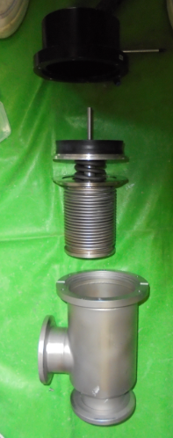
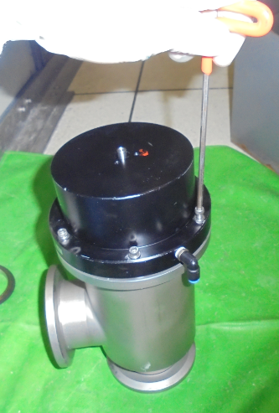
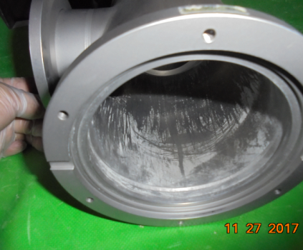
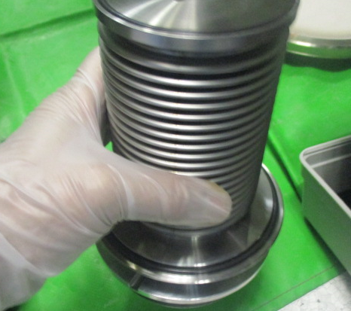
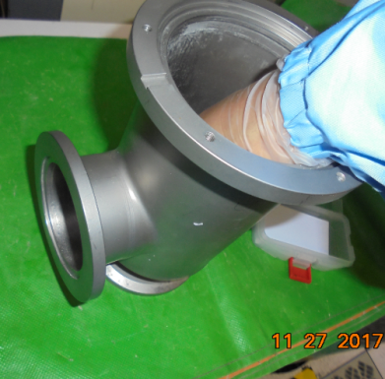
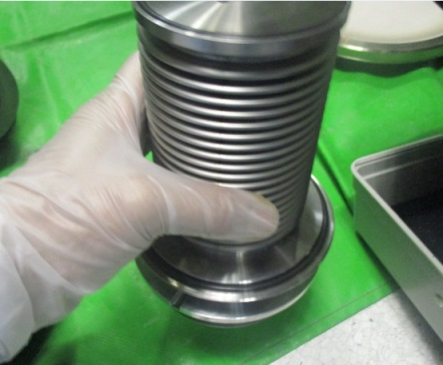
MV Cleaning Procedure
1. Remove x6 screw on top to open MV
3. Clean MV housing using cloth + IPA
4. Clean valve seal and replace all o-ring,
And assemble to install
2. Disconnect MV parts

Slide 10
Thank you

